Slide 1

Final project
By Louis Jankowski

Slide 2
Concept
This project uses a raspberry pi to control an led light using python code html and Flask

Slide 3
materials
Computer
Raspberry pi with power cable
Micro SD with adapter
A breadboard
LED
Mail to female cables
A 1k ohm resister
Keyboard, mouse, and display

Slide 4
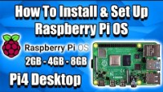
Setting Up The Raspberry Pi
Setting up a Raspberry pi is easy and simple using a computer, a micro SD card and the Raspberry pi just use these simple steps.

Slide 5
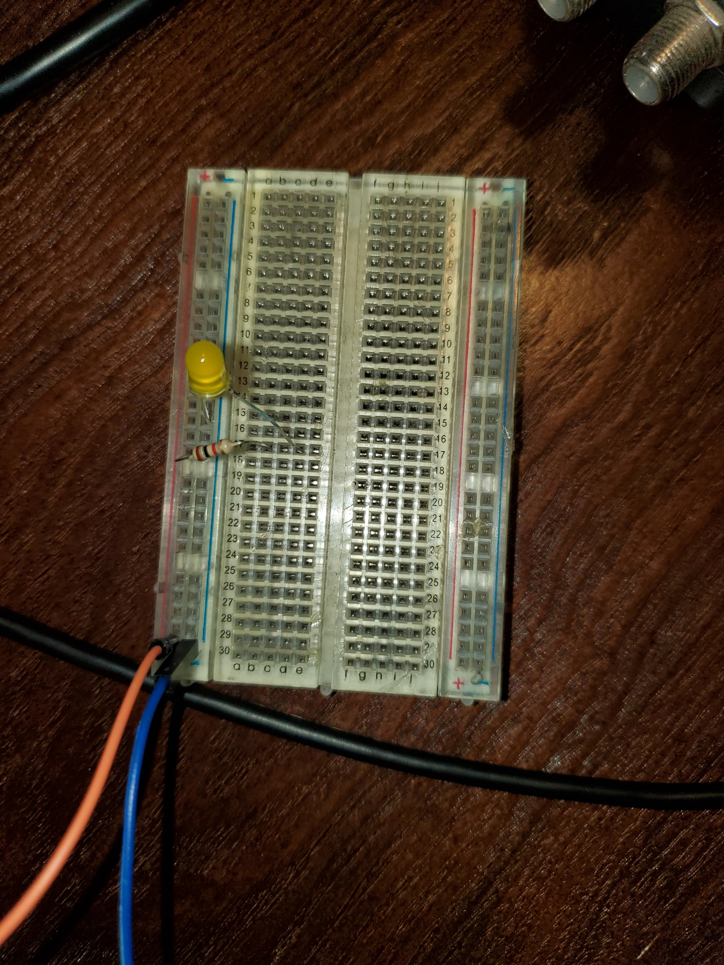
Wiring the Light
First connect the ground and signal leads to the breadboard as shown in the photo.
Then add the light to the board with the long end connected to the ground path and the short end to an open line.
Finally finish the circuit with the 1k ohm resister connecting the positive end of the light to the signal line

Slide 6
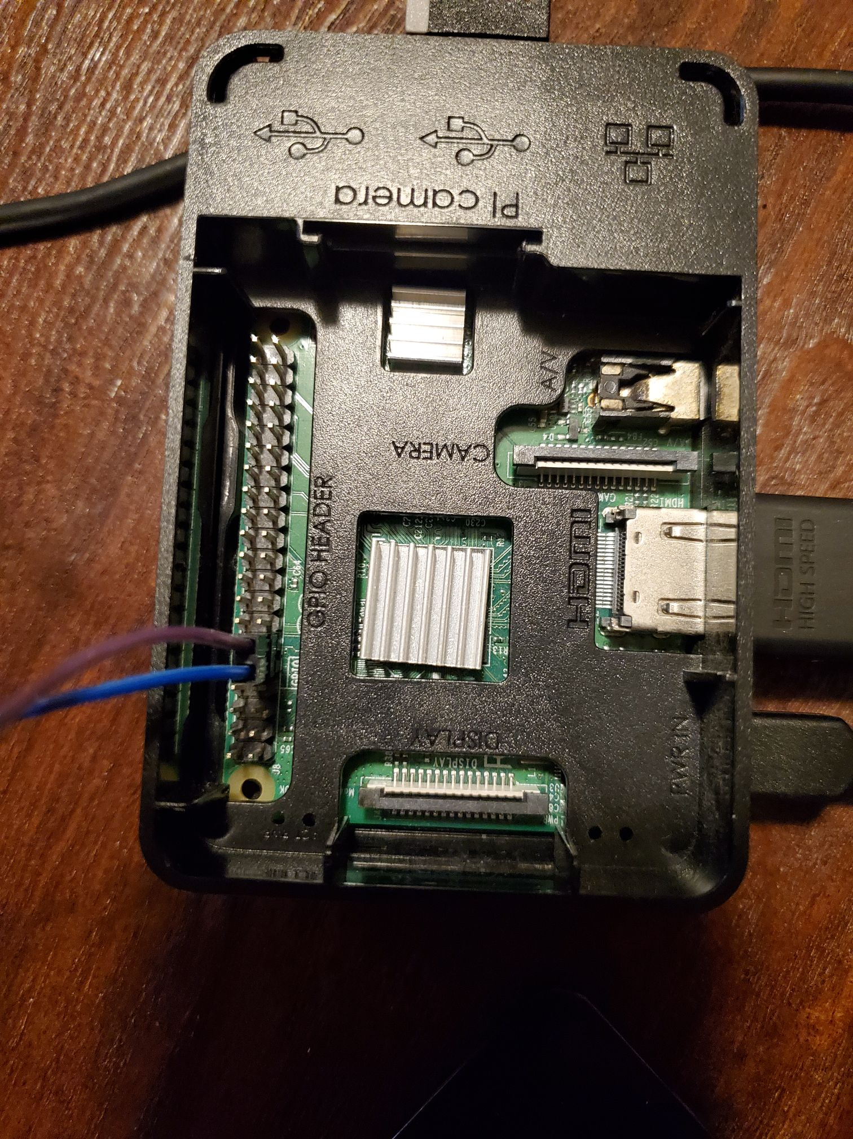
Wiring the Raspberry pi
Connect the ground to the 9th pin and the signal wire to the 11th pin known as GPIO17

Slide 7
Coding with python
Flask allows python to use routes that can handle events and can handle HTMP pages.
The python code can be found here

Slide 8
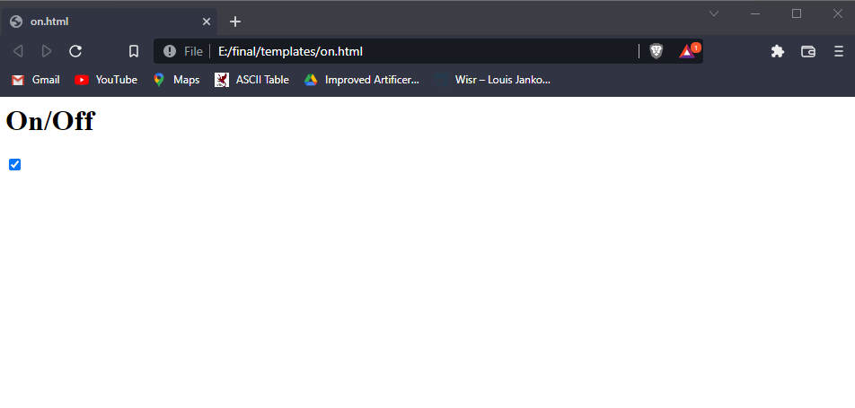
Webpage directions
The default rough starts the on page
When the button is pressed it goes to off.html

Slide 9
Coding with HTML
The HTML scripts are simple. They just submits input when the button is pressed.
This input triggers the python program to load the other route.

Slide 10
File management
The python program should be called app.py so that Flask knows how to find the program better.
The two HTML files should each be in a folder named templates so Flask knows where to find them.
app.py and templates should be in the same directory

Slide 11
Command line need to know
On the raspberry pi’s command lines 2 commands will be used two commands to get to the right directory
ls is used to list the objects in the directory
And cd wich changes the directory
Use these two commands to set the directory to the file that holds the programs

Slide 12
Using Flask
To start the application once in the correct directory enter the commands in this order
set FLASK_APP=app.py
flask run
If flask is not instaled run “pip install FLASK”

Slide 13
Testing
in order to test the program each time the server must be shut down through the command line then save whatever changes made to the code and restart server
This proses is time consuming, but I have not found a faster way to debug or test.

Slide 14
Mistakes
My largest mistake was not unplugging the raspberry pi while wiring the light. In doing so I fried my raspberry pi.
I was thankfully able to borrow a friends. This was the main mistake

Slide 15
Resources and documentation/Github
All resources and code can be found here
https://github.com/5498Louis/CPS210-final

